Slide 1

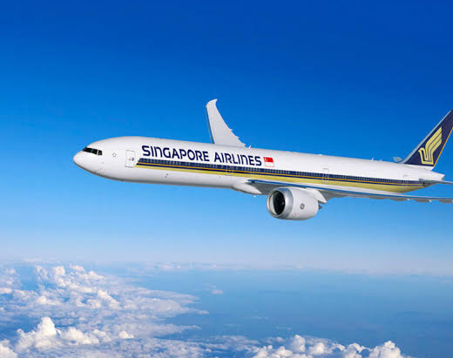
Singapore Airlines Review Analysis
Specialist Diploma in Applied Artificial Intelligence
Capstone Project 2021

Slide 2

Problem Statement
Singapore airlines receives a large volume of customer reviews containing valuable feedback about passengers’ experiences.
However, manually analysing these reviews can be time-consuming and may make it difficult to identify common concerns, positive experiences, and patterns in customer feedback.
Therefore, text analytics techniques are needed to systematically analyse the reviews and uncover meaningful insights into customer sentiment, key topics, and different groups of customer experiences.

Slide 3
Project Objectives
Analyze customer sentiment in Singapore Airlines reviews to identify positive or negative feedback and determine the main words associated with each sentiment.
Identify key topics and patterns in reviews using topic modelling and clustering to understand the main areas of customer experience.
Develop a text classification model using sentiment, dominant topic, and cluster as features to classify customer satisfaction into low, neutral, and high rating categories.

Slide 4
What is Sentiment Analysis (VADER)?
VADER (Valence Aware Dictionary and Sentiment Reasoner) is a lexicon- and rule- based sentiment analysis method, particularly effective for social media and informal text.
Produces four sources: Positive, Negative, Neutral, and Compound.
Compound score interpretation commonly used:
>= 0.05 → Positive
<= -0.05 → Negative
-0.05 to 0.05 → Neutral
Advantages: Fast, simple, no training data required, good for short/ informal text.
Limitations: May struggle with sarcasm, domain-specific terminology, and complex content.

Slide 5
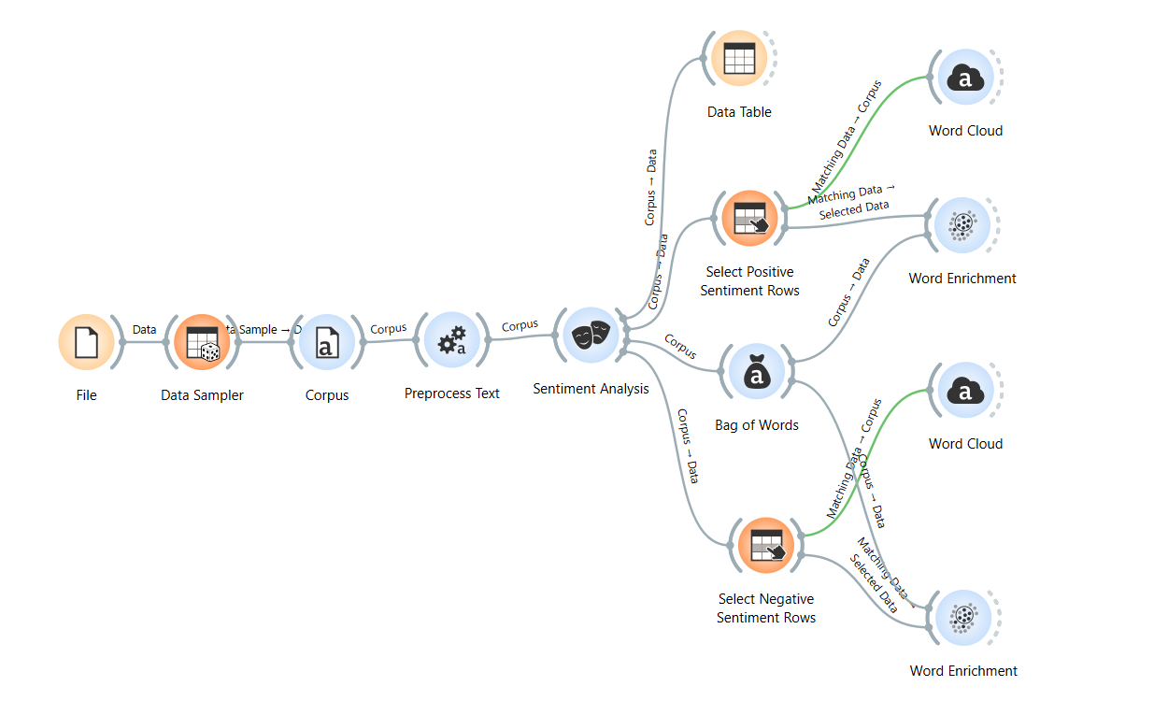
Sentiment Analysis Pipelines
The pipeline imports and samples the review data, preprocesses the text, performs sentiment analysis, and generates separate word clouds and word enrichment results for positive and negative reviews.

Slide 6
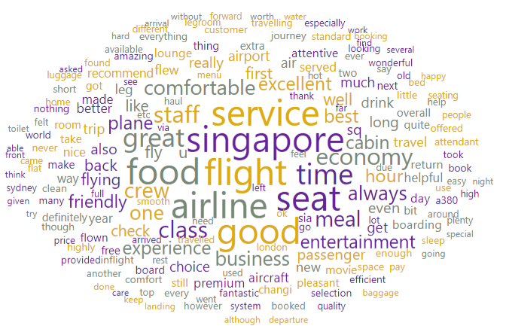
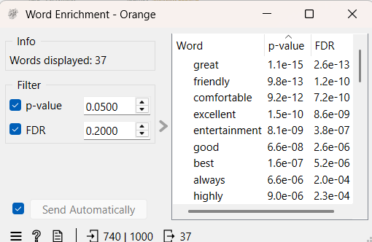
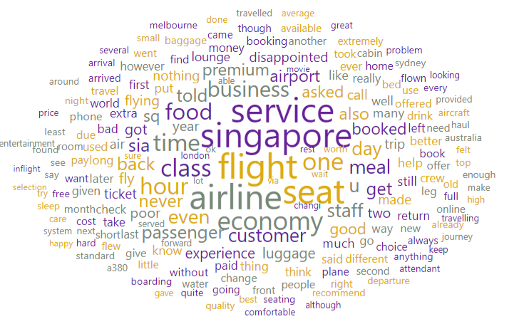
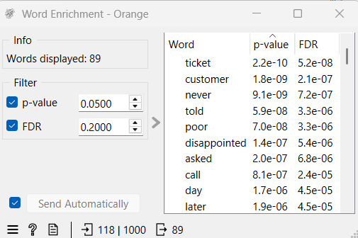
Sentiment Analysis Word Cloud & Enrichment
Positive Sentiment
Negative Sentiment

Slide 7
Insights from Sentiment Analysis
Positive Sentiment: Reviews frequently mention friendly service, comfortable experiences, excellent service, good food, and entertainment. Words such as great, friendly comfortable, and excellent are significantly enriched.
Negative Sentiment: Negative reviews focus more on tickets, customer service, poor experiences, and complaints, with enriched words such as ticket, customer, poor, disappointed, and asked. Issues also relate to food, seats, flights, and service.
Overall, positive reviews emphasise Singapore Airlines service quality and comfortable travel experience, while negative reviews mainly highlight customer service issues and problems with tickets and the overall flight experience.

Slide 8
What is Hierarchical Clustering?
Hierarchical clustering groups similar data into a hierarchy of clusters.
Euclidean Distance: Measures the straight line distance between two data points.
Smaller distances – data points are more similar
Larger distances – data points are less similar
Agglomerative Process:
Start with each data point as an individual cluster.
Calculate the Euclidean distance between clusters.
Merge the closest clusters.
Repeat until all clusters form a hierarchy.
Use a dendrogram to determine the final clusters.

Slide 9
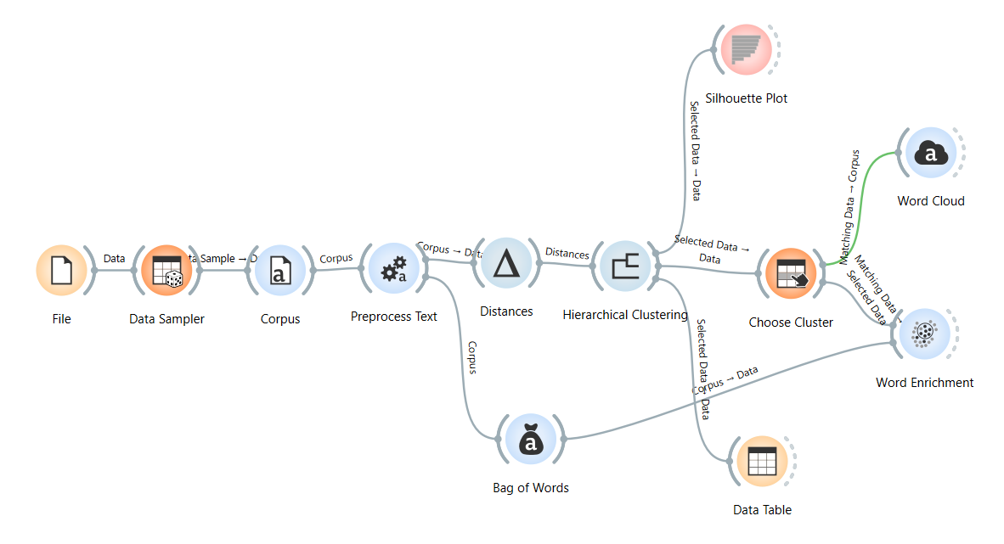
Clustering Analysis Pipelines
The pipeline preprocesses the review text, converts it into word representations, performs hierarchical clustering, evaluates the clusters using a silhouette plot, and analyses the selected clusters through word clouds and word enrichment.

Slide 10
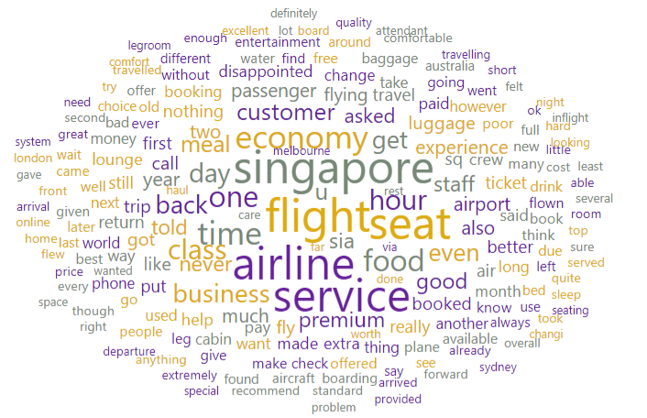
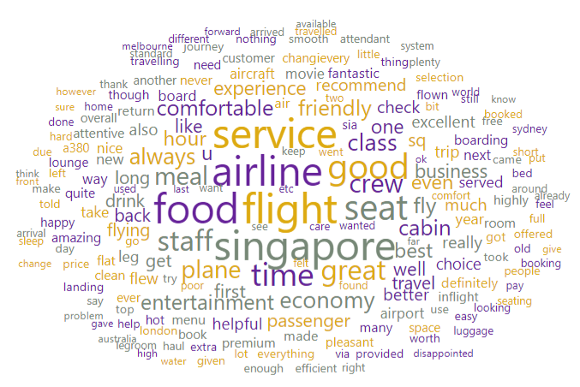
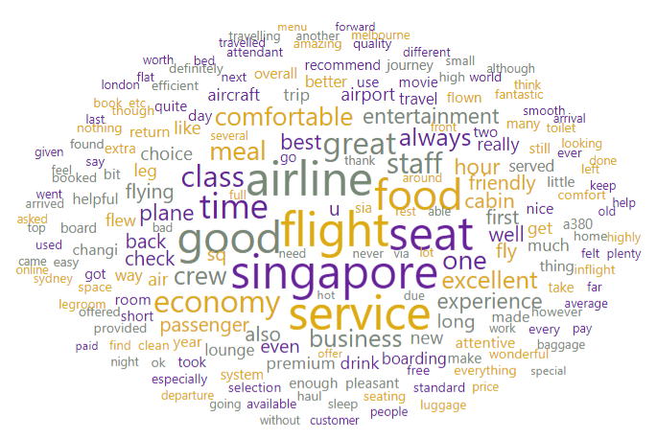
Clustering Analysis Word Cloud
C1
C2
C3

Slide 11
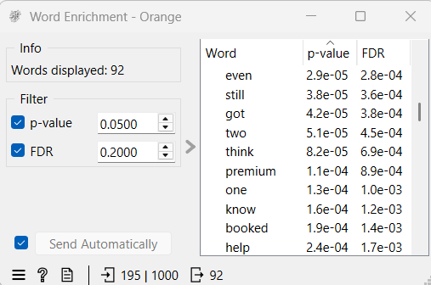
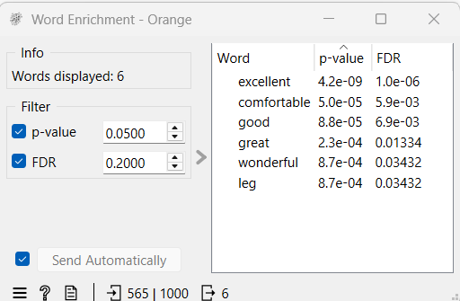
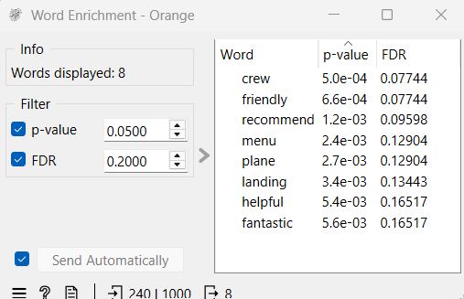
Clustering Analysis Word Enrichment
C1
C2
C3

Slide 12
Insights from Clustering Analysis
C1: Reviews focus broadly on economy class, seats, service, delays, and overall travel experience. The enriched words suggest varied passenger experiences, including booking and premium/ economy services.
C2: Reviews are strongly associated with positive experiences, with enriched words such as excellent, comfortable, good, great, and wonderful, particularly relating to comfort and service.
C3: Reviews mainly highlight crew, food/menu, flights, and landing, with crew and friendly being significantly enriched.
Overall, the clusters reveal three distinct customer experience patterns: general flight and seating experiences (C1), positive comfort and service experiences (C2), and crew and food-related experiences (C3). This shows that customer reviews can be grouped according to different aspects of the Singapore Airlines experience.

Slide 13
What is LDA?
LDA is an unsupervised topic modelling technique used to discover hidden topics in a collection of documents.
Assumes each document contains a mixture of topics.
Each topic is represented by a group of frequently associated words.
Assigns probabilities to topics within documents and words within topics.
Requires specifying the number of topics.

Slide 14
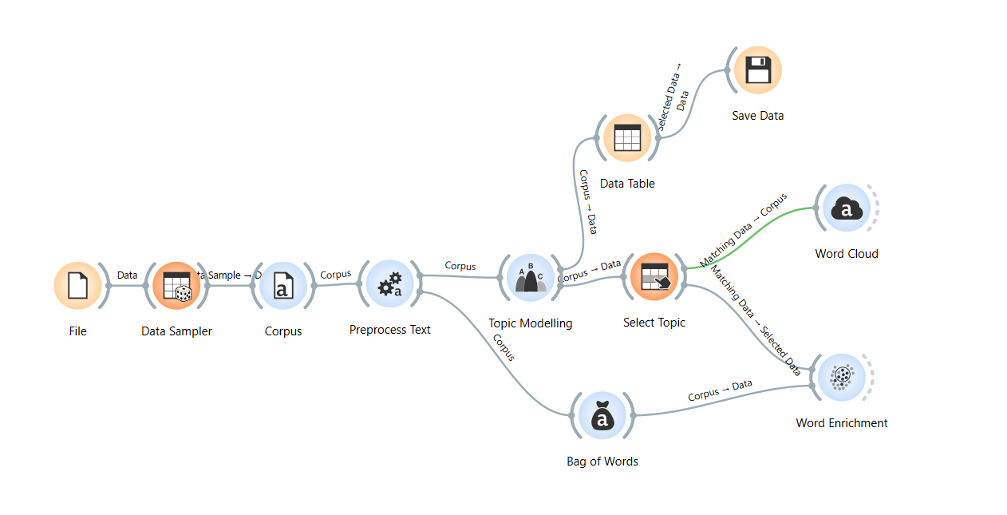
Topic-Modelling Analysis Pipelines
The pipeline preprocesses the review text, performs text modelling to identify key topics, and analyses the selected topic using a word cloud and word enrichment.

Slide 15
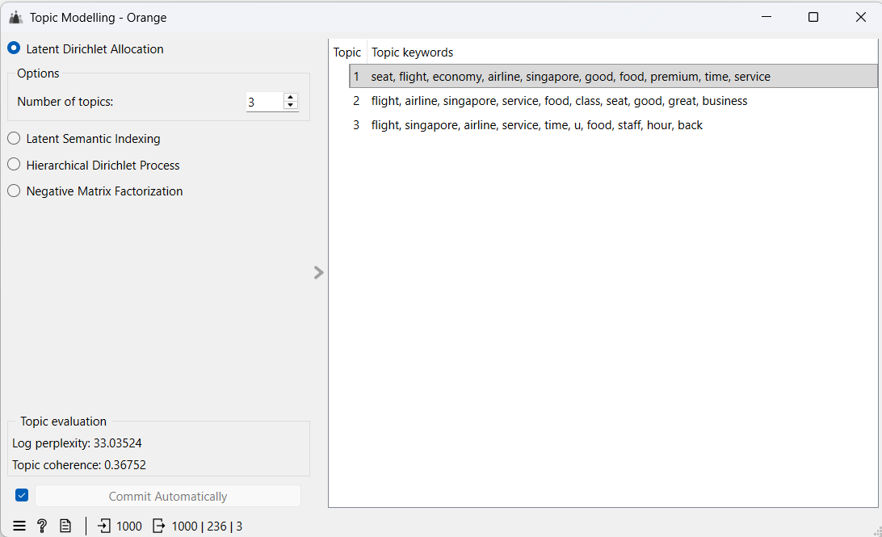
Topic Modelling (LDA)

Slide 16
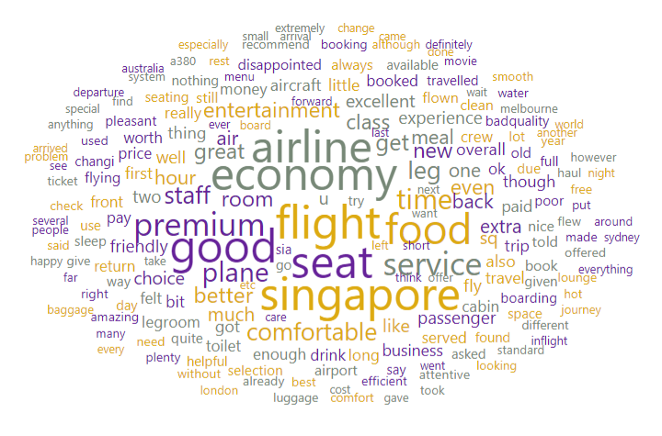
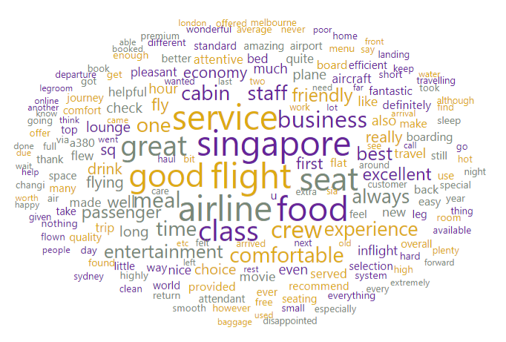
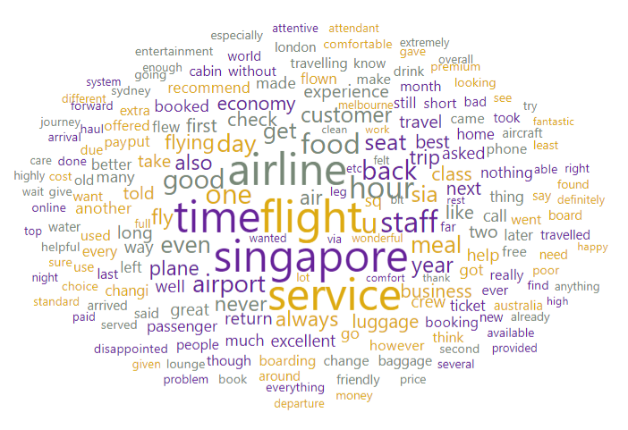
Topic Modelling Word Cloud
Topic 1
Topic 2
Topic 3

Slide 17
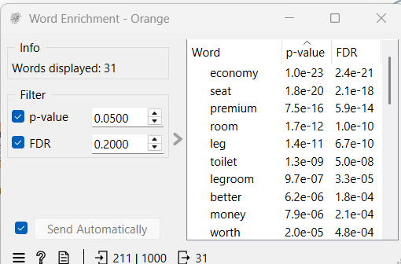
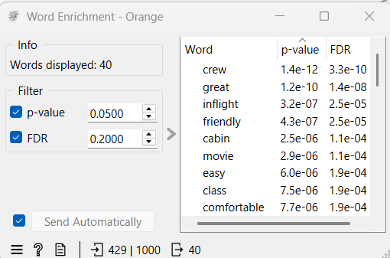
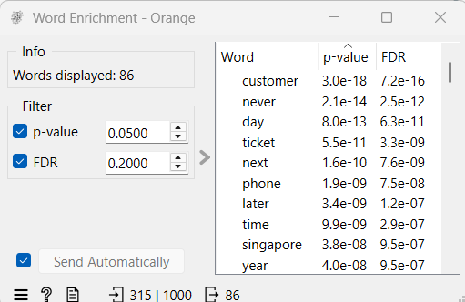
Topic Modelling Word Enrichment
Topic 1
Topic 2
Topic 3

Slide 18
Insights from Topic Modelling
Topic 1: Focuses on economy and premium travel experiences, particularly seats, flights, food , legroom, and inflight comfort.
Topic 2: Highlights service quality and cabin experience, with enriched words such as crew, great, friendly, and comfortable, indicating generally positive feedback.
Topic 3: Focuses on customer service and flight operations, including customer interactions, delays, boarding, and overall airline service.
Overall, the topic modelling identifies three main areas of customer feedback: cabin and comfort, service quality, and flight/ customer service experiences. This suggests that these factors are key themes influencing passengers’ overall experience with Singapore Airlines.

Slide 19
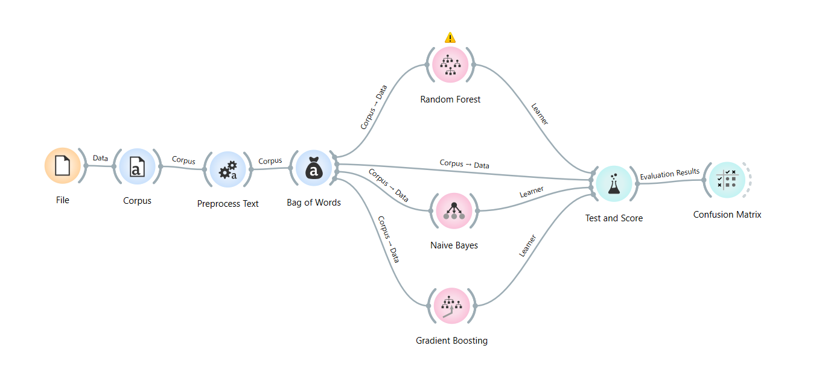
Text Classification Pipelines
The pipeline preprocesses the review text, converts it into bag of words features, trains Random Forest, Naïve Bayes, and Gradient Boosting classifiers, and evaluates their performance using cross-validation and a confusion matrix.

Slide 20
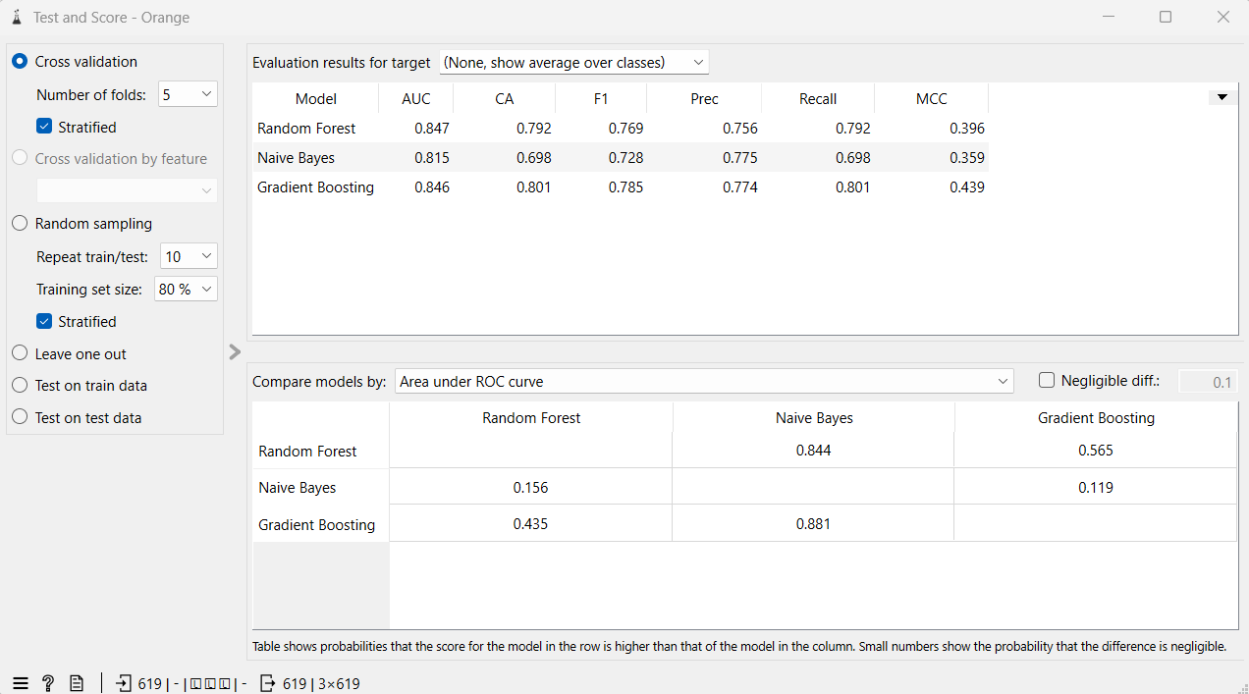
Text Classification (Cross-Validation)

Slide 21
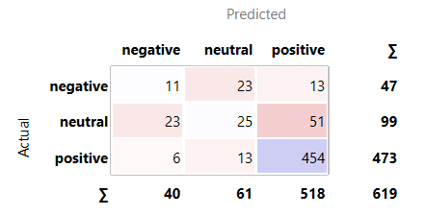
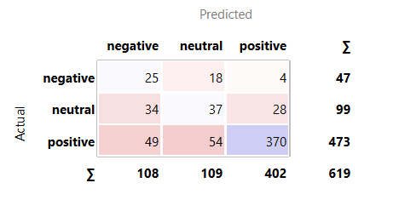
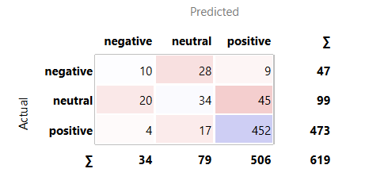
Text Classification (Confusion Matrix)
Random Forest
Naïve Bayes
Gradient Boosting

Slide 22
Insights from Text Classification
Gradient Boosting performed best overall, achieving the highest classification accuracy (0.801), F1-score (0.785), and MCC (0.439), while Random Forest had the highest AUC (0.847).
All three models classified positive reviews most accurately. However, negative and neutral reviews were more frequently misclassified, particularly as neutral or positive.
Naïve Bayes showed the weakest overall performance, with the lowest accuracy (0.698) and AUC (0.815).
Overall, the results indicate that Gradient Boosting is the most suitable model for classifying sentiment, but the models perform better for positive sentiment than negative or neutral sentiment, suggesting difficulty in distinguishing between these less frequent sentiment categories.

Slide 23
Conclusion
VADER sentiment analysis identified whether reviews expressed positive, neutral or negative opinions, showing that positive experiences were mainly associated with service, comfort, and food, while negative feedback focused more on customer service, tickets, and flight-related issues.
Euclidean hierarchical clustering further grouped similar reviews into distinct customer experience patterns, including general flight and seating experiences, positive comfort and service experiences, and crew and food-related experiences.
LDA topic modelling identified the main discussion themes, such as cabin comfort, service quality, and flight or customer service experiences.
Text classification used these review patterns to predict sentiment categories, with Gradient Boosting achieving the best overall performance, although positive reviews were classified more accurately than neutral and negative reviews due to class imbalance.

